Slide 1


Freewheel Advertisers and Simpli.Fi
Integration Details

Slide 2
Simpli.Fi Overview
Simpli.fi is a programmatic local DSP - built for localized campaigns, allowing buyers to optimize in real-time.
Local digital campaigns can be optimized across mobile, video, display and native at the localized level.
Ability to use Geofencing technology (based on IP address, mobile device ID), which enables software to trigger a response when a mobile device enters or leaves a particular area (i.e.: send ad if consumer enters specific zone and/or stop serving impressions if consumer leaves designated area)
  Location-based targeting provides an invaluable opportunity for advertisers seeking to reach consumers based on the specific geographic areas they visit. Agencies can create audiences through custom targeting shapes with pinpoint precision, even based on specific dates and times, and then serve them ads for up to 30 days after.

Slide 3
Simpli.Fi Integration Details
Agencies can accurately and quickly reconcile vendor invoices - everything displayed in FreeWheel for vendor invoice reconciliation
Ability to hyper-locally target across media types and channels - supplement or augment local offline buys with local digital inventory
Our integration allows agencies to receive daily delivery metrics from their Simpli.fi - Supported in both SBMS and Adazzle.
  Campaigns must be created in both Simpli.Fi and FWA.
  Simpli.fi Campaign ID gets entered in SBMS under External ID*.
  Metrics download 1x per day at 1am ET.
  Metric report to be sent to Adazzle must be scheduled by the Simpli.fi user in Simpli.fi UI.
Coming in 2018: Automate transfer of contract details for order management, client billing, and vendor invoicing clearance.
*See Campaign Hierarchy Slide

Slide 4
Simpli.fi - FreeWheel Hierarchy Mapping
Master Account
Strata
Account = Company
Strata Client | Agency
Advertiser
Advertiser | Client
Product
Estimate
Media Plan
Vendor
Simpli.fi
Budget Line/Order by Tactic
Line Item
DSP budget line by Tactic
Use Simpli.Fi’s Budget Line/Order by Tactic External ID

Slide 5
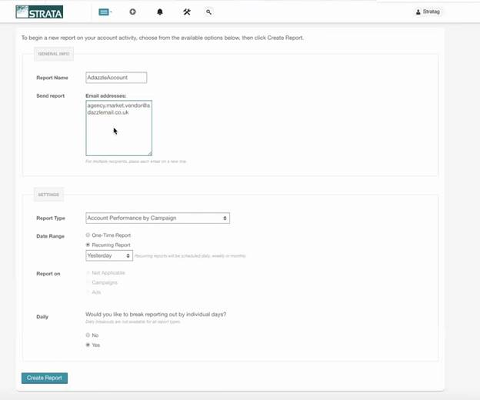
FWA/Simpli.Fi – Schedule Simpli.fi report to be sent to Freewheel
The Campaign Management Reports can be scheduled to be sent to Freewheel daily :
TAPS will create an email for each agency. That email must be used in scheduling the report by Simpli.fi. This only needs to be set up once by Simpli.fi. It does not have to be done for each campaign.
Report Type should be Account Performance by Campaign
Date Range should be Reoccurring Report
Report needs to be broken out by individual days

Slide 6
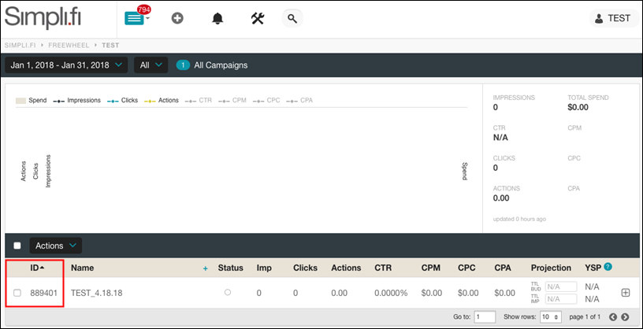
FWA/Simpli.Fi – Simpli.Fi Campaign Details
This Simpli.Fi campaign ID/Tactic is entered into FreeWheel to link the two campaigns together.

Slide 7
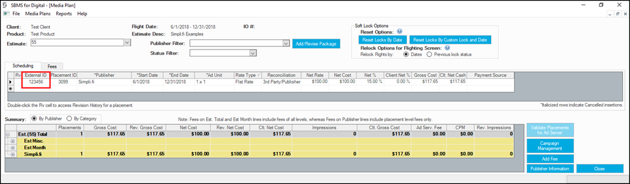
FWA/Simpli.Fi – SBMS Media Plan
Media Plan Screen:
Requires Simpli.fi Campaign ID to be entered in SBMS under External ID. The Campaign ID is set at the Tactic level in Simpli.fi. A budget line should be created in SBMS Media Plan for each Tactic.
External ID available in Show/Hide Columns/General Options
Reconciliation must be set to 3rd Party/Publisher

Slide 8
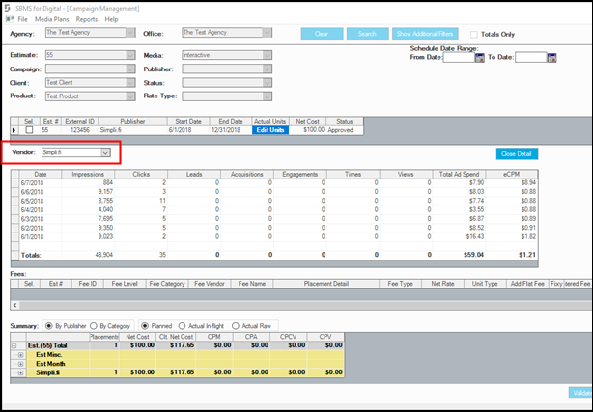
FWA/Simpli.Fi – SBMS Campaign Management
Campaign Management Screen:
Simpli.fi Metrics are viewable by right clicking in Show Actuals OR
Selecting Edit Units which displays daily/placement total for metrics and Total Ad Spend
eCPM is calculated by Impressions and Total Ad Spend
Total Ad Spend and eCPM was added in Show/Hide columns under Actual Units

Slide 9
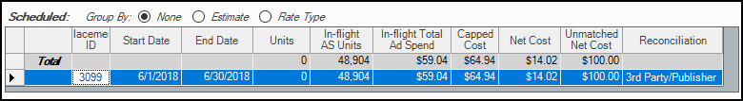
FWA/Simpli.Fi – SBMS Invoice Reconciliation
Invoice Reconciliation Screen:
Raw Served $ and In-Flight Served $ will be changed to Raw Total Ad Spend and In-Flight Total Ad Spend in Show/Hide columns and in Reconciliation and Matched Grids
The Total Ad Spend will have values only if the vendor has the DSP flag is set to true and Reconciliation is set to 3rd Party/Publisher in Media Plan
The Capped Cost is reflecting the Total Ad Spend if the selected Vendor is Simpli.fi.
Amount to Pay value in Matched grid is verified against Total Ad Spend, invoice cost, and the financial control settings.

